Slide 1
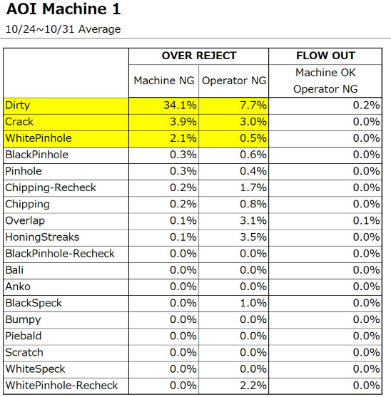
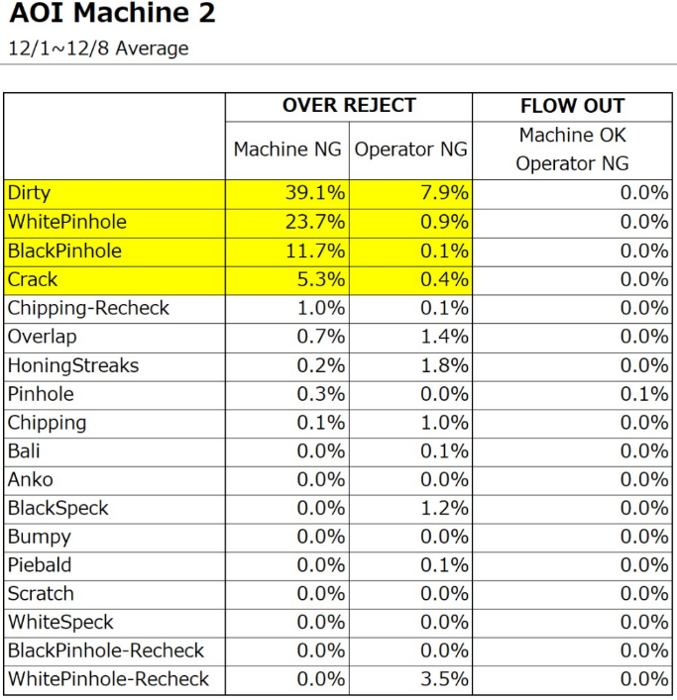
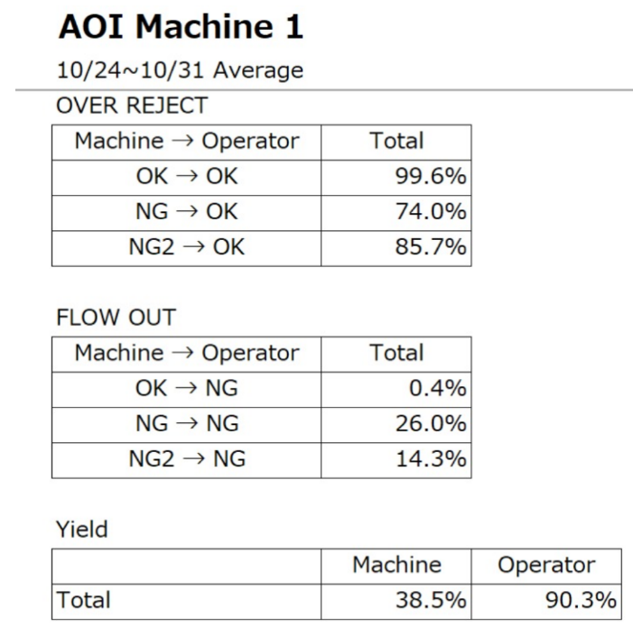
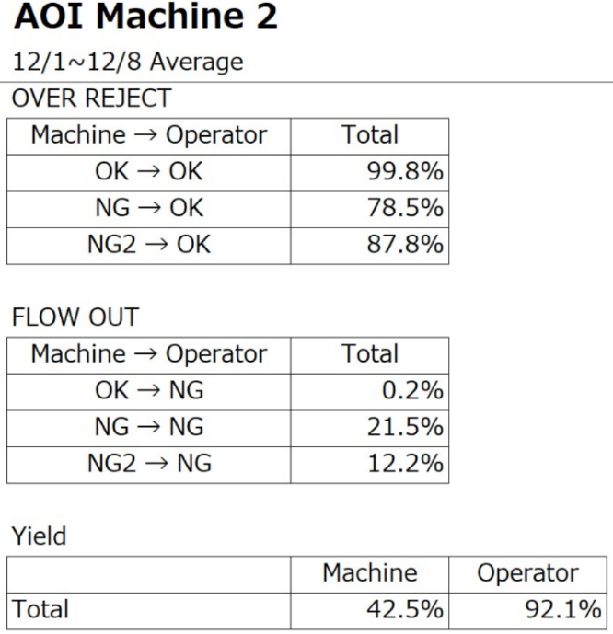
Current Yield Status – SN AOI Machine
MARUWA JAPAN
Target AOI Yield – Action item
Jan/04 ➔ 75%
Jan/12 ➔ 80%
Jan/20 ➔ 85%
Jan/26 ➔ 90%
Target : Jan’26 ➔ 90%

Slide 2
SN AOI Machine Performance Meeting Minutes 19/Jan

